Slide 1
Meeting with Oksana
20/03

Slide 2
Tasks From Last Meeting
Ball Tracker Network
Fix Cuda
Look into how the data is fed into the network. See how to implement time
Explore snn torch theory
Labelling
Check how I am generating the images. Binary result is not ideal for the labelling.
Logarithmic transformation to get better size labelling

Slide 3
Completed Tasks

Slide 4
Fix cuda
The cuda version in the system is not relevant
Only the pytorch-cuda version needs to be compatible with the libraries
Pytorch 2.5.1
Pytorch-cuda 12.4
Torchvision 0.20.1
Snntorch 0.9.4

Slide 5
Time Implementation in the SNN Input
For static images I am using 100 timesteps and then changing the image.
For whole time-series sequences I still have to see what do I do with the missing labels. If I can successfully classify images without time dimension this wouldn’t be worth it I think. It would increase the difficulty of achieving this task that is technically already solved while I could be generating a continuous dataset with IsaacSim.

Slide 6
How Data is Fed
I implemented downsampling of the images and labels to make training easier and faster.
I cropped the images. My plan was to generate all of them already cropped, but the tracking was not working correctly with the new images.

Slide 7
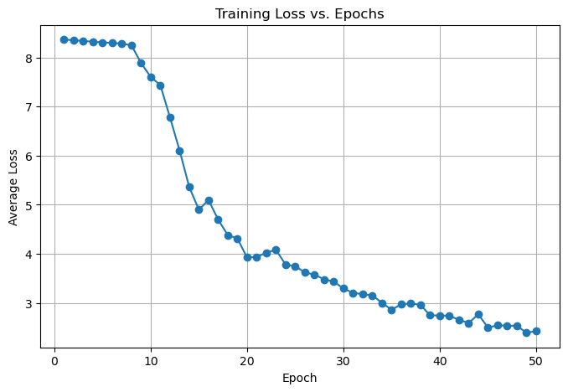
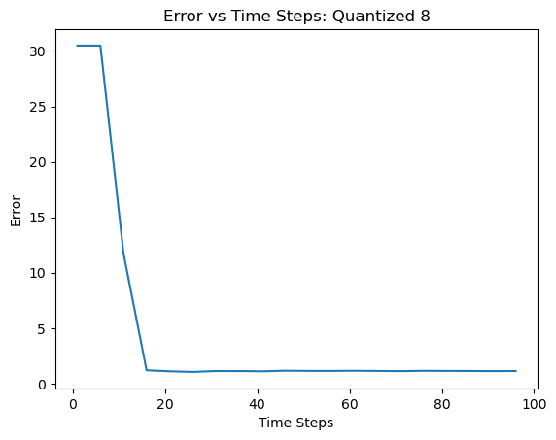
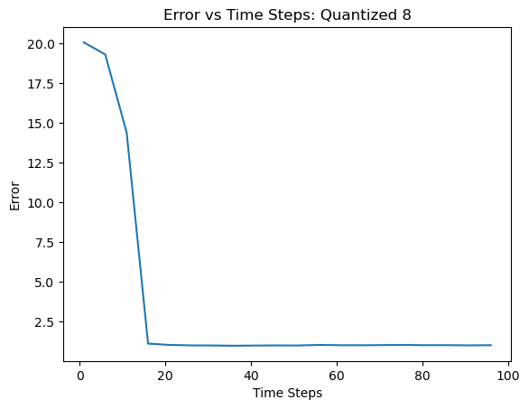
Finally Trained Some Models
Quantization 8
100 timesteps
50 epochs
21 minutes
Batch size = 50
Learning rate = 0.001
Latency: 0.2 s
Training for 20 timesteps 100 epochs took 14 minutes with similar results
(I made cuda run synchronously at some point so training times may not be accurate)

Slide 8
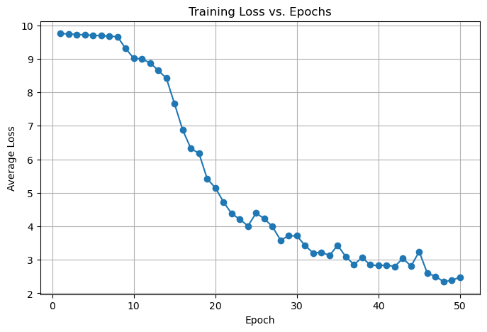
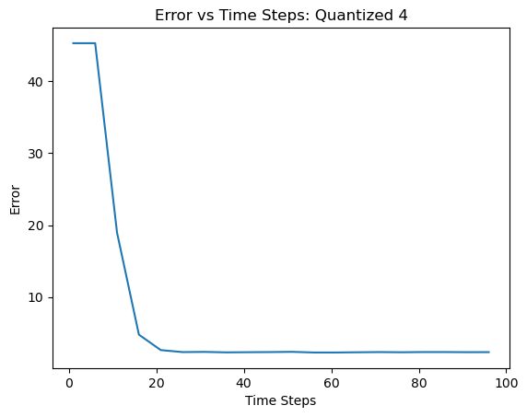
Quantization 4
100 timesteps
50 epochs
254 minutes
Latency: 0.2
GASP Quantization 8
Local minimum at around 7.5
100 epochs
100 steps
Learning rate = 0.0005
Batch size

Slide 9
Ongoing and Proposed Future Tasks

Slide 10
Ongoing Tasks
Transformation to Polar Coordinates
I am not sure if it is worth it anymore, results are similar or worse to those of the Hough Circle.
Maybe better results can be obtained.

Slide 11
Proposed Future tasks
Work on the implementation of a dataset with trajectories instead of images
Start generating trajectories with IsaacSim

Slide 12
Future Tasks
Do uncertainty propagation for the final product and define goals
Also getting to know the actual state of this uncertainty
Try regression to get grasp of the accuracy trade off.
Work on the implementation of a dataset with trajectories instead of images
Start generating trajectories with IsaacSim
Simulator constraint field of view

